Slide 1
The Croak Twins
From Pads to Riches
A game by Ben Reynolds and Elliot Page

Slide 2
Concept
A two-player local multiplayer game.
Centred around destructive gameplay.
Achieved using a swing mechanic.
Aimed at 18-24 year old males.
For PC, released as a standalone.

Slide 3

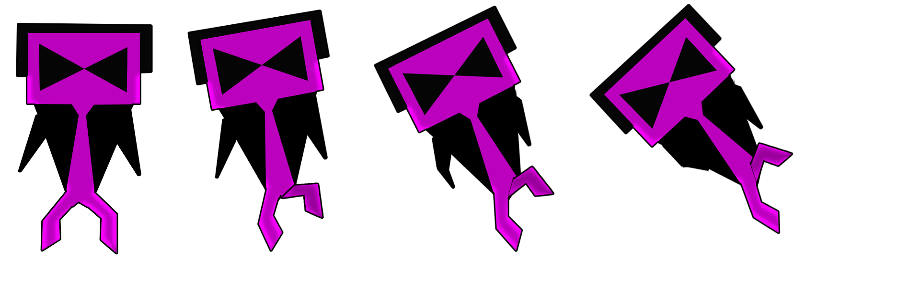

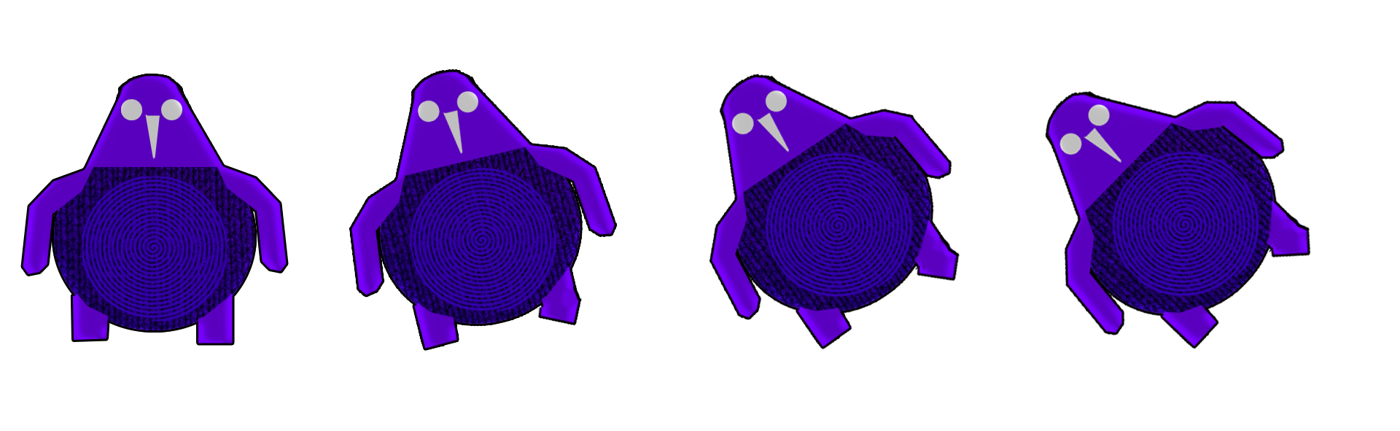
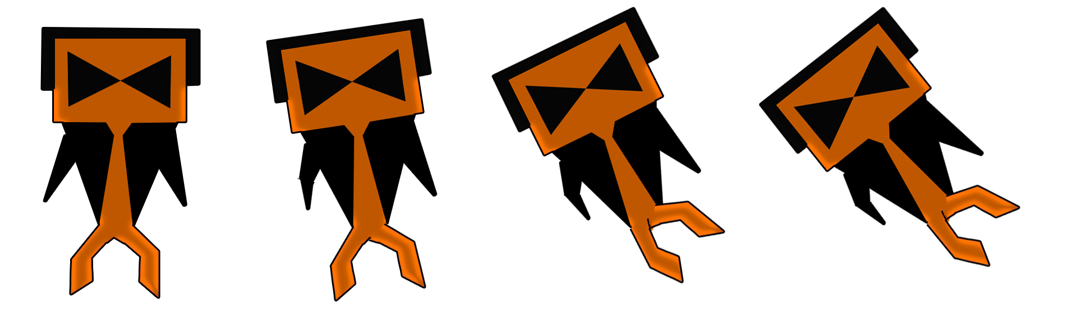
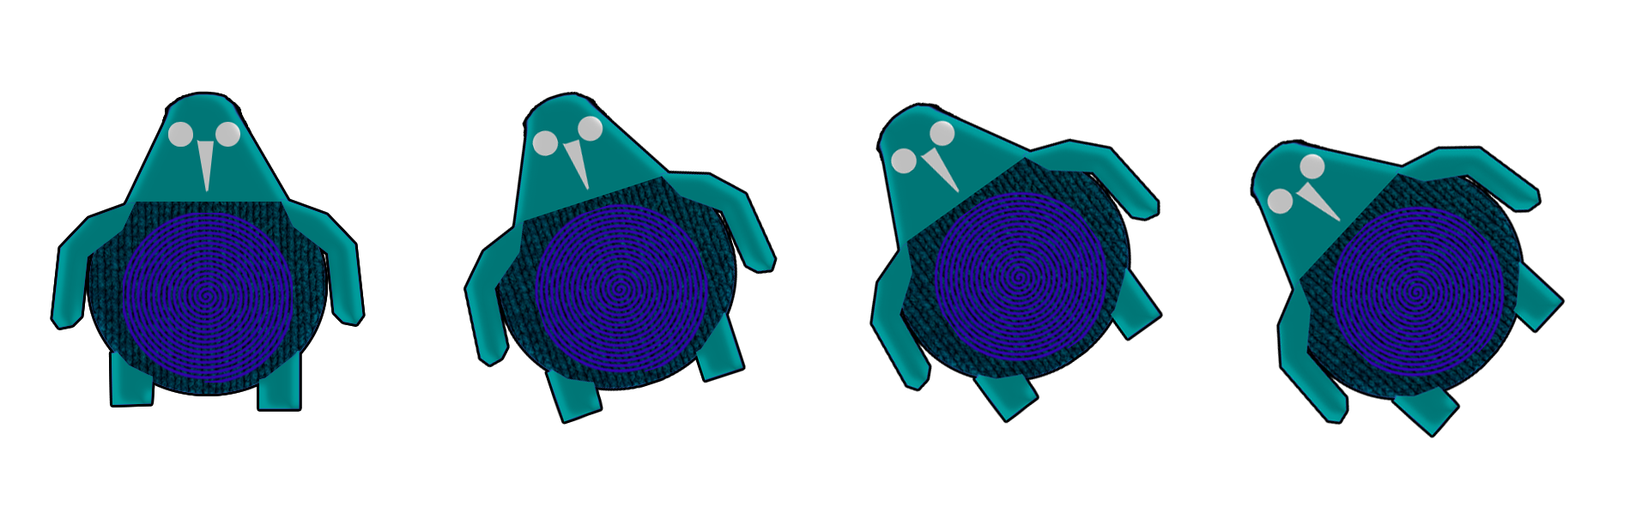

Art Style (Iterations)

Slide 4


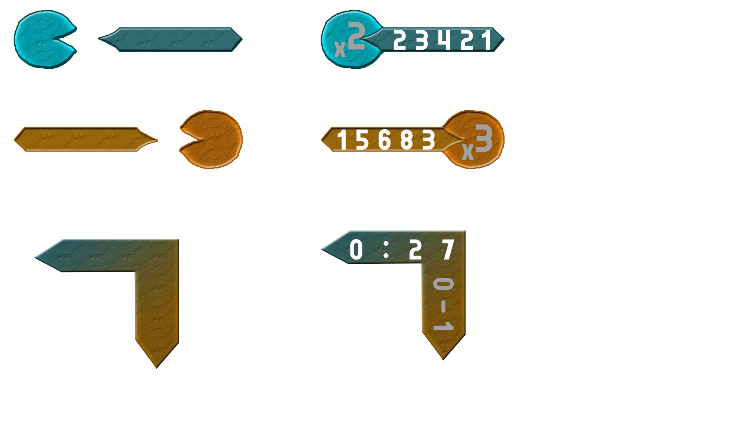
Art Style (Final)

Slide 5
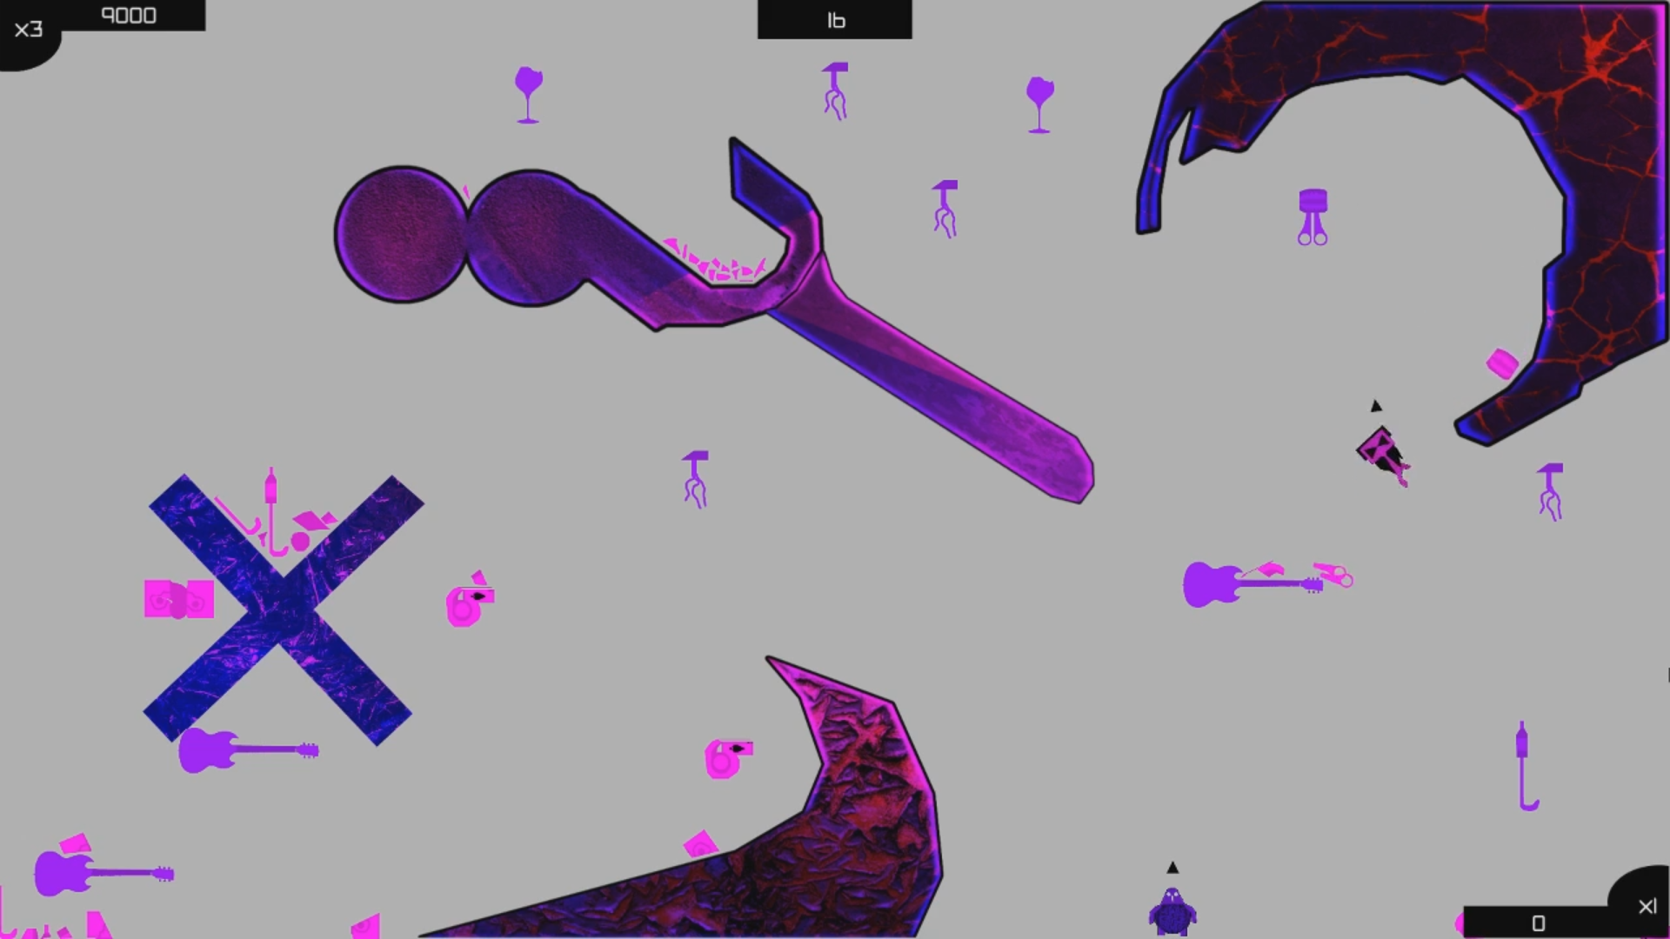
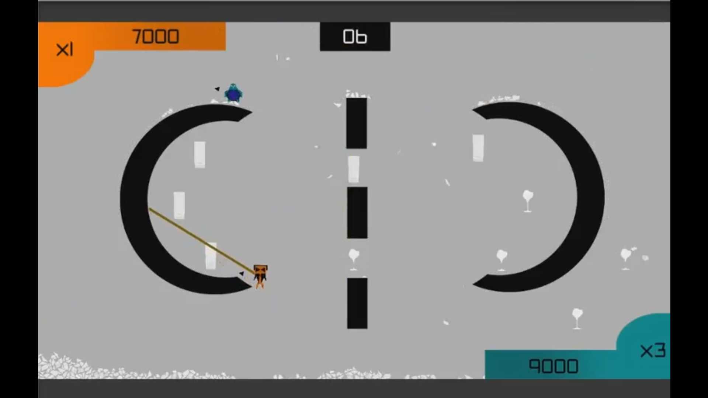
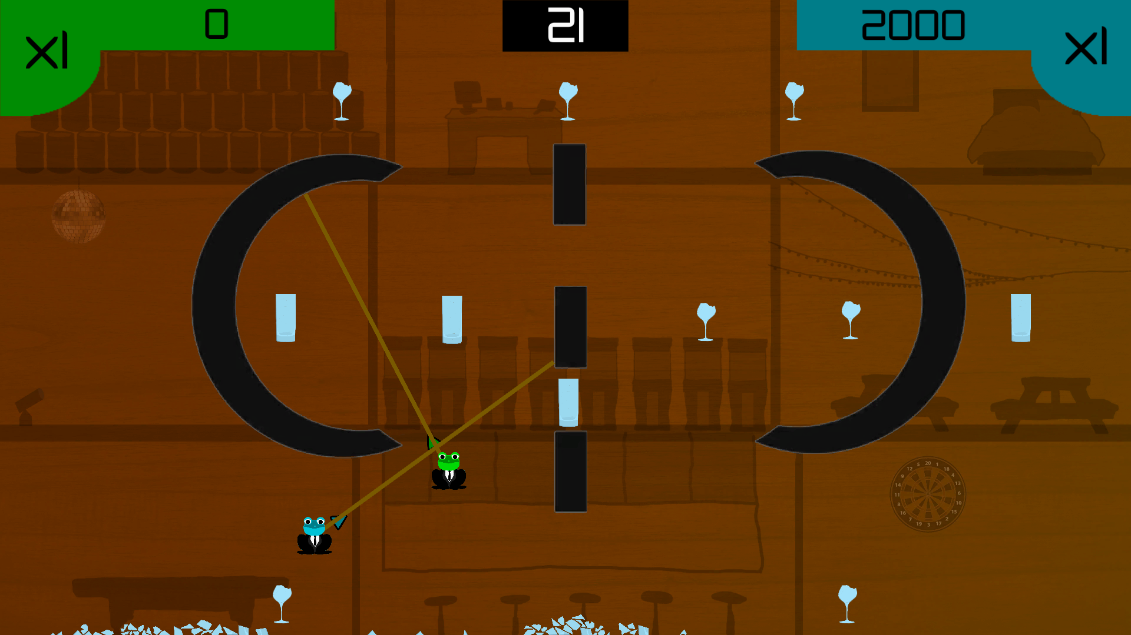
Gameplay (Iterations)
(Game Here)

Slide 6
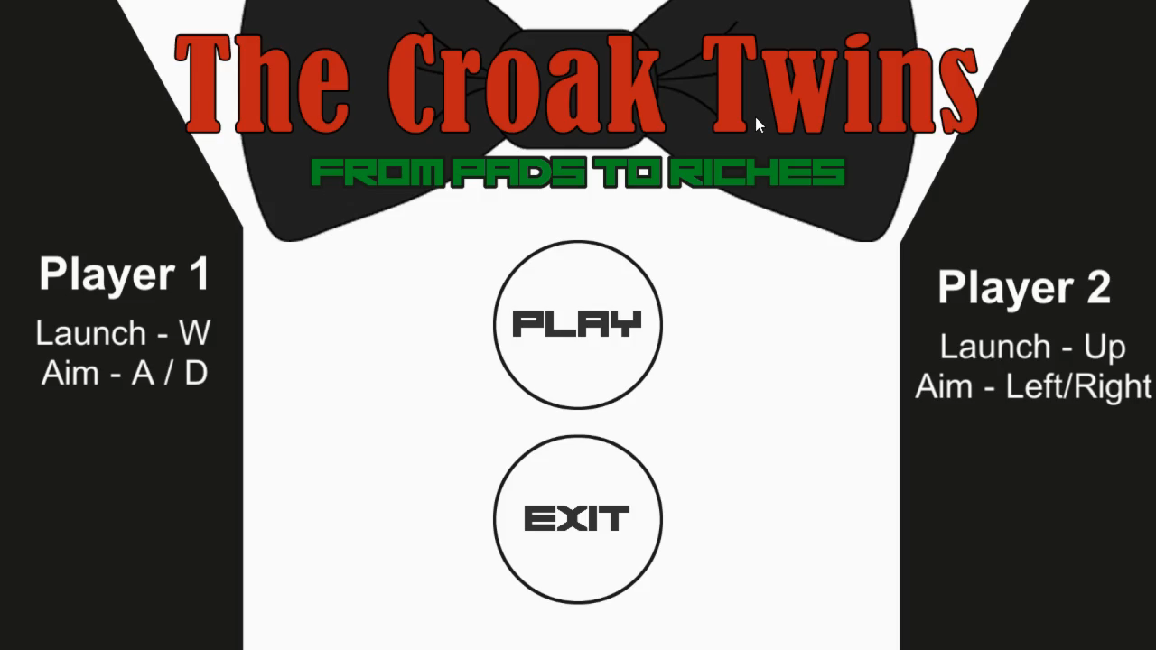
Gameplay (Final)

Slide 7
Feedback
“The new colour scheme is much better and the bigger reticule makes aiming the grapple hook easier.”
“I feel like it’s a polished experience”
“I like the chaos of smashing into stuff”
“I feel like maybe you should be able to ricochet off stuff”
“It doesn’t feel like there is much competition.”

Slide 8
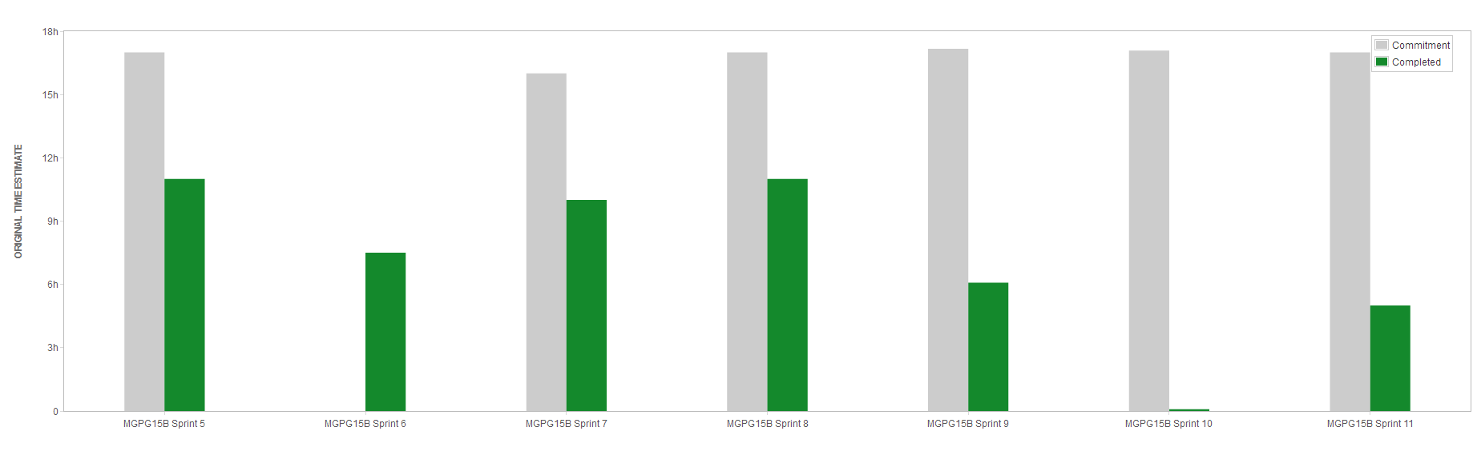
Teamwork/Management

Slide 9
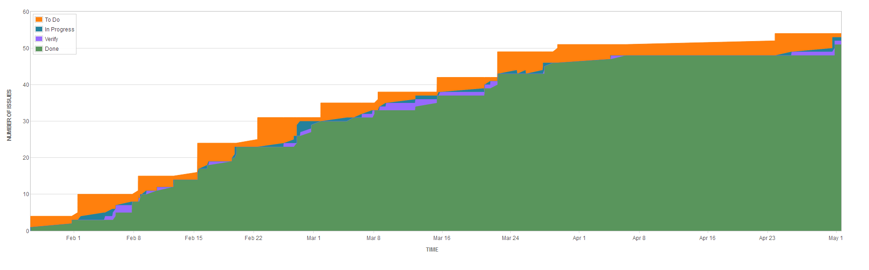
Teamwork/Management

